Slide 1
Attributes of Hierarchical Paradigm
03/04/25

Slide 2
Hierarchical paradigm
sequential and orderly
First the robot senses the world and constructs a global world map.
Then “eyes” closed, the robot plans all the directives needed to reach the goal.
Finally, the robot acts to carry out the first directive. After the robot has carried out the SENSE-PLAN-ACT sequence, it begins the cycle again: eyes open, the robot senses the consequence of its action, replans the directives (even though the directives may not have changed), and acts.

Slide 3
World Model
Sensing in the Hierarchical Paradigm is monolithic
All the sensor observations are fused into one global data structure, which the planner accesses. The global data structure is generally referred to as a world model.
“world” means both the outside world, and whatever meaning the robot ascribes to it.

Slide 4
World model
In hierarchical paradigm, world model contains the following:
1. an a priori (previously acquired) representation of the environment the
robot is operating in (e.g., a map of the building),
2. sensing information (e.g., “I am in a hallway, based on where I’ve traveled,
I must be in the northwest hallway”)
3. any additional cognitive knowledge that might be needed to accomplish
a task (e.g., all packages received in themail need to be delivered to Room
118).

Slide 5
Frame Problem
The problem of representing a real-world situation in a way that was computationally tractable became known as the frame problem.

Slide 6
Closed world assumption
The closed world assumption says that the world model contains everything the robot needs to know: there can be no surprises.
If the closed world assumption is violated, the robot may not be able to function correctly.
Challenge: It is very easy to forget to put all the necessary details into the world model. As a result, the success of the robot depends on how well the human programmer can think of everything.

Slide 7
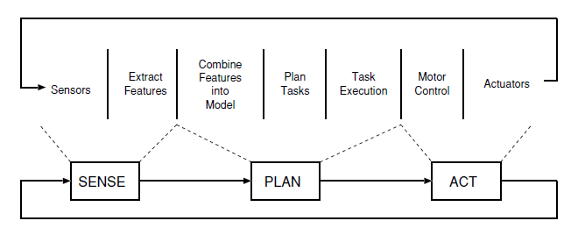
Hierarchical paradigm is seen to have a horizontal decomposition of the S,P,A.

Slide 8
Shakey
First AI robot
Built by SRI (Stanford Research Institute) for DARPA 1967-9
Used Strips as main algorithm for controlling what to do

Slide 9
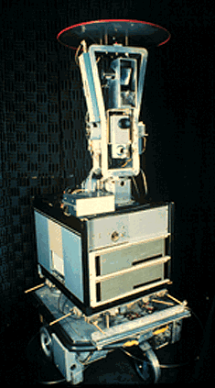
Shakey
First AI robot
Built by SRI (Stanford Research Institute) for DARPA 1967-9
Used Strips as main algorithm for controlling what to do

Slide 10
Shakey
Used Strips as main algorithm for controlling what to do.
STRIPS - Stanford Research Institute Problem Solver
variant of the General Problem Solver (GPS)
Strips uses means-ends analysis
if the robot can’t accomplish the task or reach the goal in one “movement”, it picks an action which will reduce the difference between what state it was in now (e.g., where it was) versus the goal state (e.g., where it wanted to be).

Slide 11
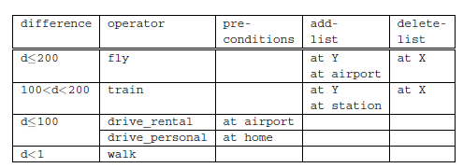
Shakey

Slide 12
Shakey
The robot can have a initial state and goal state.
The robot may represent the decision process of how to get to a location as function called an OPERATOR which would consider the Euclidean distance (a variable named DIFFERENCE) between the goal state and initial state.
The difference between locations could be computed for comparison purposes, or evaluation, by the square of the hypotenuse. (DIFFERENCE EVALUATOR).
Leads to a data structure called a DIFFERENCE TABLE of how to make decisions.

Slide 13
Shakey
first step in creating a Strips planner is to construct a Strips-based representation of the world, or WORLD MODEL.
Everything in the world that is relevant to the problem is represented by facts, or AXIOMS, in predicate logic.
Predicates are functions that evaluate to TRUE or FALSE.
A world model is generally built up from static facts (represented as predicates) from a set of candidates, and things in the world, like the robot.
Once the world model is established, it is possible to construct the difference table.
If a predicate is not in the current world state,then is referred to as a FAILED PRECONDITION.
Rather than give up, STRIPS recurses (uses the programming technique of recursion) to repeat the entire procedure.

Slide 14
Challenges
Creating a single representation which can store all of the information.
reason for the “sub-turtle” velocity was the lack of computing power during the 1960s.
Researchers found that even with increased computing power, the hierarchical, logic-based approach was unsatisfactory for navigational tasks which require a rapid response time to an open world.
Closed world assumption and frame problem

Slide 15
Advantages of Hierarchical paradigm
Hierarchical architectures tend to support the evolution of intelligence from semi-autonomous control to fully autonomous control.
Provides an ordering of the relationship between sensing, planning, and acting

Slide 16
Disadvantages of Hierarchical paradigm
Planning can be very slow and the “global world” representation has to further contain all information needed for planning.
Sensing and acting are always disconnected.
The “global world” representation has to be up-to-date.
The world model used by the planner has to be frequently updated to achieve a sufficient accuracy for the particular task.
A general problem solver needs many facts about the world to search for a solution.
Searching for a solution in a huge search space is quickly computationally intractable and the problem is related to the so-called frame problem.
Even simple actions need to reason over all (irrelevant) details.
Frame problem is a problem of representing the real-word situations to be computationally tractable. It can be seen as decomposition of the world model into parts that best fit the type of actions.

Slide 17
Attributes of Reactive Paradigm
03/04/25

Slide 18
Reactive paradigm
emerged in the late 1980’s.
It can be studied for 2 reasons:
robotic systems in limited task domains are still being constructed using reactive architectures
It will form the basis for the Hybrid Reactive-Deliberative paradigm.
Reactive Paradigm grew out of dissatisfaction with the hierarchical paradigm and with an influx of ideas from ethology.

Slide 19
Reactive paradigm-vertical decomposition
Reactive paradigm can be seen as vertical decomposition w.r.t S-A.
Under a vertical decomposition, an agent starts with primitive survival behaviors and evolves new layers of behaviors which either reuse the lower, older behaviors, inhibit the older behaviors, or create parallel tracks of more advanced behaviors.
The parallel tracks can be thought of layers, stacked vertically.
Each layer has access to sensors and actuators independently of any other layers.
If anything happens to an advanced behavior, the lower level behaviors would still operate. This return to a lower level mimics degradation of autonomous functions in the brain.

Slide 20
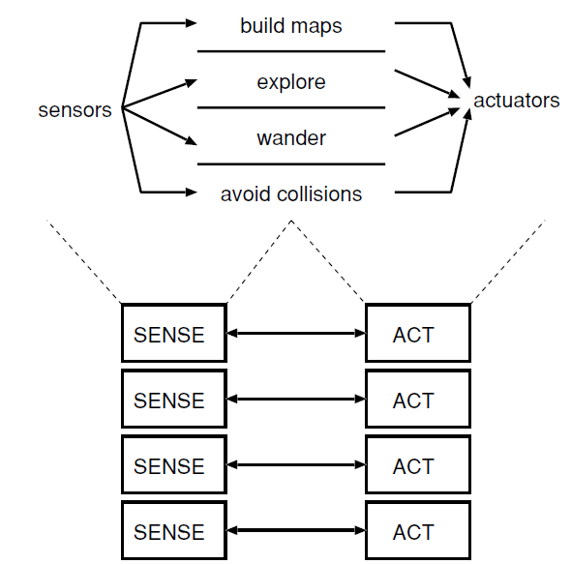

Slide 21
Reactive paradigm
reactive behaviors are not amenable to mathematical proofs showing they are sufficient and correct for a task.
rapid execution times associated with the reflexive behaviors.
discrete behaviors combine to form a rich emergent behavior.

Slide 22
Attributes of Reactive paradigm
all actions are accomplished through behaviors.

Slide 23
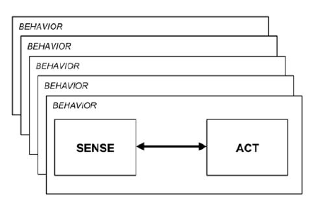
Behaviour
direct mapping of sensory inputs to a pattern of motor actions that are then used to achieve a task.

Slide 24
Attributes of Reactive paradigm
all actions are accomplished through behaviors.
behaviors are simply a transfer function, transforming sensory inputs into actuator commands.
a behavior will be treated as a schema, and will consist of at least one motor schema and one perceptual schema.
The motor schema contains the algorithm for generating the pattern of action in a physical actuator.
The perceptual schema contains the algorithm for extracting the percept and its strength.
The S-A organization does not specify how the behaviors are coordinated and controlled.

Slide 25
Attributes of Reactive paradigm
Sensing in the Reactive Paradigm is local to each behavior, or behavior-specific. Each behavior has its own dedicated sensing.
In many cases, this is implemented as one sensor and perceptual schema per behavior.
But in other cases, more than one behavior can take the same output from a sensor and process it differently (via the behavior’s perceptual schema).
One behavior literally does not know what another behavior is doing or perceiving.

Slide 26
Attributes of Reactive paradigm
Sensing is immediately available to the behavior’s perceptual schema, which can do as little or as much processing as needed to extract the relevant percept. If a computationally inexpensive affordance is used, then the sensing portion of the behavior is nearly instantaneous and action is very rapid.
In early implementations of the reactive paradigm, the idea of “one sensor, one behavior” worked well.
For more advanced behaviors, it became useful to fuse the output of multiple sensors within one perceptual schema to have increased precision or a better measure of the strength of the stimulus. This type of sensor fusion is permitted within the reactive paradigm as long as the fusion is local to the behavior.

Slide 27
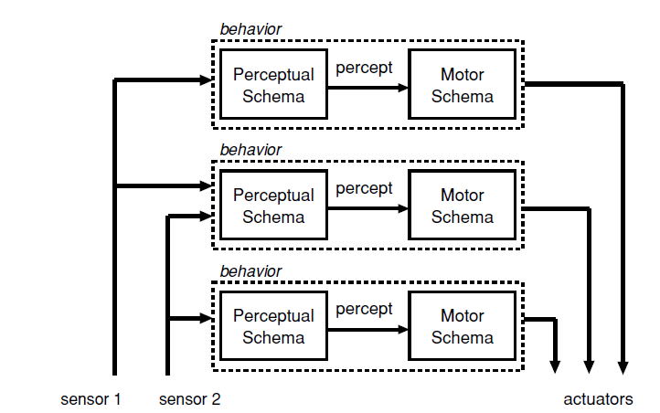

Slide 28
Connotations of reactive behaviour
primary connotation of a reactive robotic system is that it executes rapidly. The tight coupling of sensing and acting permits robots to operate in real-time with higher speeds than Shakey. Behaviors can be implemented directly in hardware as circuits, or with low computational complexity algorithms (O(n)).
secondary connotation is that reactive robotic systems have no memory, limiting reactive behaviors (biologists would call this pure stimulus-response reflexes). In practice, many behaviors exhibit a fixed-action pattern type of response, where the behavior persists for a short period of time without the direct presence of the stimulus. Behaviors are controlled by what is happening in the world, duplicating the spirit of innate releasing mechanisms, rather than by the program storing and remembering what the robot did last.

Slide 29
Characteristics of reactive behaviour
Robots are situated agents operating in an ecological niche.
Behaviors serve as the basic building blocks for robotic actions, and the overall behavior of the robot is emergent.
Only local, behavior-specific sensing is permitted.
These systems inherently follow good software design principles.
Animal models of behavior are often cited as a basis for these systems or a particular behavior.

Slide 30
Characteristics of reactive behaviour
Robots are situated agents operating in an ecological niche.
Situated agent means that the robot is an integral part of the world.
A robot has its own goals and intentions. When a robot acts, it changes the world, and receives immediate feedback about the world through sensing.What the robot senses affects its goals and how it attempts to meet them, generating a new cycle of actions.
the goals of a robot, the world it operates in, and how it can perceive the world form the ecological niche of the robot.

Slide 31
Characteristics of reactive behaviour
Behaviors serve as the basic building blocks for robotic actions, and the overall behavior of the robot is emergent.
Behaviors are independent, computational entities and operate concurrently.
The overall behavior is emergent: there is no explicit “controller” module which determines what will be done, or functions which call other functions. There may be a coordinated control program in the schema of a behavior, but there is no external controller of all behaviors for a task.

Slide 32
Characteristics of reactive behaviour
Only local, behavior-specific sensing is permitted.
The use of explicit abstract representational knowledge in perceptual processing, even though it is behavior-specific, is avoided.
Any sensing which does require representation is expressed in ego-centric (robot-centric) coordinates.
In the case of obstacle avoidance, an ego-centric representation means that it does not matter that an obstacle is in the world at coordinates (x,y,z), only where it is relative to the robot. Sensor data, with the exception of GPS, is inherently ego-centric (e.g., a range finder returns a distance to the nearest object from the transducer), so this eliminates unnecessary processing to create a world model, then extract the position of obstacles relative to the robot.

Slide 33
Characteristics of reactive behaviour
These systems inherently follow good software design principles.
The modularity of these behaviors supports the decomposition of a task into component behaviors.
The behaviors are tested independently, and behaviors may be assembled from primitive behaviors.

Slide 34
Characteristics of reactive behaviour
Animal models of behavior are often cited as a basis for these systems or a particular behavior.
use animals as a motivation for a collection of behaviors.

Slide 35
Advantages of programming by behavior
Behaviors are inherently modular and easy to test in isolation from the system (i.e., they support unit testing). Behaviors also support incremental expansion of the capabilities of a robot. A robot becomes more intelligent by having more behaviors. The behavioral decomposition results in an implementation that works in real-time and is usually computationally inexpensive. Sometimes duplicating specialized detectors is slow. If the behaviors are implemented poorly, then a reactive implementation can be slow.
Behaviors support good software engineering principles through decomposition, modularity and incremental testing.

Slide 36
Advantages of programming by behavior
If programmed with as high a degree of independence (also called low coupling) as possible, and high cohesion, the designer can build up libraries of easy to understand, maintain, and reuse modules that minimize side effects.
Low coupling means that the modules can function independently of each other with minimal connections or interfaces, promoting easy reuse.
Cohesion means that the data and operations contained by a module relate only to the purpose of that module. Higher cohesion is associated with modules that do one thing well.

Slide 37
Biological Foundations for Reactive Paradigm
11/03/24

Slide 38
Agent
self-contained and independent.
Has its own “brains” and can interact with the world to make changes or to sense what is happening.
From OOP perspective, “agent” is the superclass and the classes of “person” and “robot” are derived from it.

Slide 39
Agency
Agency is a concept in artificial intelligence that allows researchers to discuss the properties of intelligence without discussing the details of how the intelligence got in the particular agent.

Slide 40
Levels of Computational theory
Level 1
Level 2
Level 3
David Marr,neurophysiologist

Slide 41
Levels of Computational theory
Level 1: Existence proof of what can/should be done.
At Level 1, agents can share a commonality of purpose or functionality.

Slide 42
Levels of Computational theory
Level 2:Decomposition of “what” into inputs, outputs, and transformations.
can be thought of as creating a flow chart of “black boxes.” Each box represents a transformation of an input into an output.
At Level 2, agents can exhibit common processes.

Slide 43
Levels of Computational theory
Level 3:How to implement the process.
This level of the computational theory focuses on describing how each transformation, or black box, is implemented.
At Level 3, agents may have little or no commonality in their implementation.

Slide 44
Levels of Computational theory
Levels 1 and 2 are abstract enough to apply to any agent.
It is only at Level 3 that the differences between a robotic agent and a biological agent really emerge.
by focusing on Level 2 of a computational theory of intelligence, roboticists can gain insights into how to organize intelligence.

Slide 45
Behaviour
A behavior is a mapping of sensory inputs to a pattern of motor actions which then are used to achieve a task.
fundamental building block of natural intelligence.
Science of study animal behaviors is called as ethology.
Scientists who study animal behaviors are called ethologists.

Slide 46
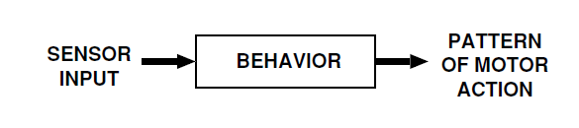

Slide 47
Types of Behaviour
Reflexive behaviors: These are stimulus-response (S-R) based. These are connected to the response in order to produce the fastest response time.
Reactive behaviors: Reactive behaviors are learned, and then consolidated to where they can be executed without conscious thought. Any behavior that involves what is referred to in sports as “muscle memory” is usually a reactive behavior (e.g., riding a bike, skiing). Reactive behaviors can also be changed by conscious thought.
Conscious behaviors: These are deliberative (assembling a robot kit, stringing together previously developed behaviors, etc.).

Slide 48
Significance of characterization of behaviours
First, the reactive paradigm will make extensive use of reflexive behaviors, to the point that some architectures only call a robot behavior a behavior if it is S-R.
The categorization can help a designer determine what type of behavior to use, leading to insights about the appropriate implementation.
The use of the word “reactive” in ethology is at odds with the way the word is used in robotics. In ethology, reactive behavior means learned behaviors or a skill; in robotics, it connotes a reflexive behavior.

Slide 49
IRM
Konrad Lorenz and Niko Tinbergen were the founding fathers of ethology.
Independently became fascinated not only with individual behaviors of animals, but how animals acquired behaviors and selected or coordinated sets of behaviors.
four ways to acquire a behavior are: a)Innate(to be born with a behavior), b)to be born with a sequence of innate behaviors, c) to be born with behaviors that need some initialization (innate with memory) and d) to learn a set of behaviors.
internal state and/or motivation of an agent may play a role in releasing a behavior. i.e motivation serves as a stimulus for behavior. Behaviors can be sequenced to create complex behaviors.

Slide 50
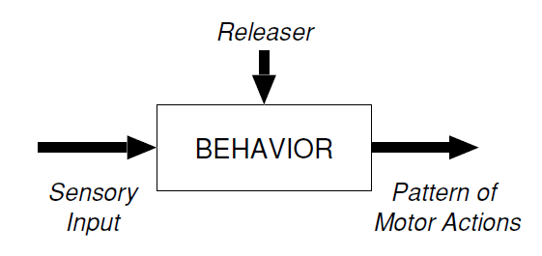
IRM
innate releasing mechanisms (IRM).
An IRM presupposes that there is a specific stimulus (either internal or external) which releases, or triggers, the stereotypical pattern of action. The IRM activates the behavior. A releaser is a latch or a Boolean variable that has to be set. Can be as a simple computer program.
specify when a behavior gets turned on and off. The releaser acts as a control signal to activate a behavior.

Slide 51
Principles and Issues in Transferring Insights to Robots
Some general principles of natural intelligence which may be useful in programming robots are:
Programs should decompose complex actions into independent behaviors, which tightly couple sensing and acting. Behaviors are inherently parallel and distributed.

Slide 52
Principles and Issues in Transferring Insights to Robots
Some general principles of natural intelligence which may be useful in programming robots are:
Programs should decompose complex actions into independent behaviors, which tightly couple sensing and acting. Behaviors are inherently parallel and distributed.
In order to simplify control and coordination of behaviors, an agent should rely on straightforward, boolean activation mechanisms (e.g. IRM).

Slide 53
Principles and Issues in Transferring Insights to Robots
Some general principles of natural intelligence which may be useful in programming robots are:
Programs should decompose complex actions into independent behaviors, which tightly couple sensing and acting. Behaviors are inherently parallel and distributed.
In order to simplify control and coordination of behaviors, an agent should rely on straightforward, boolean activation mechanisms (e.g. IRM).
In order to simplify sensing, perception should filter sensing and consider only what is relevant to the behavior (action-oriented perception).

Slide 54
Principles and Issues in Transferring Insights to Robots
Some general principles of natural intelligence which may be useful in programming robots are:
Programs should decompose complex actions into independent behaviors, which tightly couple sensing and acting. Behaviors are inherently parallel and distributed.
In order to simplify control and coordination of behaviors, an agent should rely on straightforward, boolean activation mechanisms (e.g. IRM).
In order to simplify sensing, perception should filter sensing and consider only what is relevant to the behavior (action-oriented perception).
Direct perception (affordances) reduces the computational complexity of sensing, and permits actions to occur without memory, inference, or interpretation.

Slide 55
Principles and Issues in Transferring Insights to Robots
Some general principles of natural intelligence which may be useful in programming robots are:
Programs should decompose complex actions into independent behaviors, which tightly couple sensing and acting. Behaviors are inherently parallel and distributed.
In order to simplify control and coordination of behaviors, an agent should rely on straightforward, boolean activation mechanisms (e.g. IRM).
In order to simplify sensing, perception should filter sensing and consider only what is relevant to the behavior (action-oriented perception).
Direct perception (affordances) reduces the computational complexity of sensing, and permits actions to occur without memory, inference, or interpretation.
Behaviors are independent, but the output from one 1) may be combined with another to produce a resultant output, or 2) may serve to inhibit another (competing-cooperating).

Slide 56
Issues in Transferring Insights to Robots
How to resolve conflicts between concurrent behaviors? Robots will be required to perform concurrent tasks. Should the designer specify dominant behaviors? Combine? Let conflicting behaviors cancel and have alternative behavior triggered? Indeed, one of the biggest divisions in robot architectures is how they handle concurrent behaviors.

Slide 57
Issues in Transferring Insights to Robots
How to resolve conflicts between concurrent behaviors? Robots will be required to perform concurrent tasks. Should the designer specify dominant behaviors? Combine? Let conflicting behaviors cancel and have alternative behavior triggered? Indeed, one of the biggest divisions in robot architectures is how they handle concurrent behaviors.
When are explicit knowledge representations and memory necessary? :Can a designer be sure that an affordance has not been missed?

Slide 58
Issues in Transferring Insights to Robots
How to resolve conflicts between concurrent behaviors?: Robots will be required to perform concurrent tasks. Should the designer specify dominant behaviors? Combine? Let conflicting behaviors cancel and have alternative behavior triggered?
When are explicit knowledge representations and memory necessary? : Can a designer be sure that an affordance has not been missed?
How to set up and/or learn new sequences of behaviors?: Learning appears to be a fundamental component of generating complex behaviors in advanced animals.

Slide 59
Attributes of Hybrid Paradigm
03/04/25

Slide 60
Attributes of Hybrid Paradigm
PLAN includes all deliberation and global world modeling, not just task or path planning.
The robot would first plan how to accomplish a mission (using a global world model) or a task, then instantiate or turn on a set of behaviors (SENSE-ACT)to execute the plan (or a portion of the plan).
The behaviors would execute until the plan was completed, then the planner would generate a new set of behaviors, and so on.
Hybrid Paradigm is an extension of the Reactive Paradigm

Slide 61
Attributes of Hybrid Paradigm
Two assumptions made in this paradigm are:
planning covers a long time horizon and requires global knowledge, so it should be decoupled from real-time execution just on the software engineering principle of coherence (dissimilar functions should be placed in different objects)
planning and global modeling algorithms are computationally expensive, so they should be decoupled from real-time execution just from a standpoint of practicality because they would slow down the reaction rate.

Slide 62
Attributes of Hybrid Paradigm
Sensing Organization is complex.
In hybrid paradigm, behavior is usually more consistent with the ethological use and includes reflexive, innate, and learned behaviors.
Hybrid implementations tend to use assemblages of behaviors sequenced over time, rather than primitive behaviors.
deliberative portion of a Hybrid architecture contains modules and functions for things which are not easy to represent in reactive behaviors.
Some of these functions clearly require a global world model like path planning and map making.

Slide 63
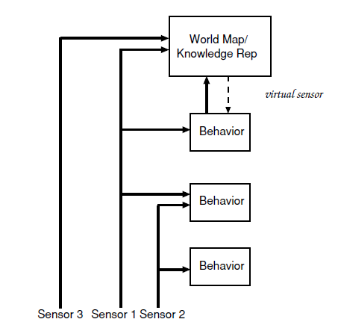

Slide 64
Attributes of Hybrid Paradigm
PLAN includes all deliberation and global world modeling, not just task or path planning.
The robot would first plan how to accomplish a mission (using a global world model) or a task, then instantiate or turn on a set of behaviors (SENSE-ACT)to execute the plan (or a portion of the plan).
The behaviors would execute until the plan was completed, then the planner would generate a new set of behaviors, and so on.
primitives in the hybrid paradigm is conceptually divided into a reactive (or reactor) portion and a deliberation (or deliberator) portion.

Slide 65
Attributes of Hybrid Paradigm
Behavorial management (planning which behaviors to use) requires knowing something about the current mission and the current (and projected) state of the environment. This is global knowledge in that it requires the module to know something outside of itself.
Performance monitoring:Sees if the robot is actually making progress to its goal, and problem solving is a global activity.
Rule of thumb in hybrid paradigm is that functions which operate on symbolic information go in the deliberative layer, or deliberator, while functions which transform sensor data into actuator commands go in the reactive layer, or reactor.

Slide 66
THANK YOU

